Slide 1
Meiosis
Chapter 4.3 Guided Notes

Slide 2
Let’s review….
Mitosis produces two genetically identical daughter cells.
In sexual reproduction, offspring inherit traits from both parents (the mother and the father).
Genetic traits are inherited in predictable patterns.

Slide 3
Meiosis is necessary for sexual reproduction.
Most human cells (body cells) contain 46 chromosomes (23 pair).
Any cell that contains the full number of chromosomes (two sets) for a species is a 2n cell, or diploid cell.

Slide 4
Gametes
Gametes are cells that contain half the usual number of chromosomes- one chromosome from each pair.
Gametes are 1n cells, and also called haploid cells. Human gametes contain 23 unpaired chromosomes.
Gametes are found only in the reproductive organs.
An egg is the gamete that forms in a female.
A sperm is the gamete that forms in a male.

Slide 5
Fertilization
During sexual reproduction, two gametes combine to become a 2n cell that can grow into a new offspring.
Fertilization is the process that occurs when a sperm and egg combine to form one new cell.
The egg (23 chromosomes) and the sperm (23 chromosomes) combine to form a new 2n cell with 46 chromosomes.

Slide 6
Mitosis vs. Meiosis
Body cells divide by mitosis.
Each daughter cell formed by mitosis is a standard diploid (2n) cell.
But to produce gametes (which are haploid), a different kind of division is necessary- this is called meiosis.
Meiosis produces haploid (1n) cells. During meiosis, a single cell goes through two cell divisions- meiosis I and meiosis II.
Meiosis only occurs in the reproductive tissues of an organism.

Slide 7
Cells divide twice during meiosis.
Before meiosis begins, chromosomes of the parent cell are copied, so there are now two copies of each chromosome pair- twice as many as usual.
So, to end up with cells that have half the usual number of chromosomes, there must be two divisions.

Slide 8
Meiosis I
Remember, two chromosomes in a pair are called homologs.
During meiosis I, the homologs separate and the starting cell divides into two cells.
One cell contains the two copies of one homolog of each pair, while the other cell contains the two copies of the other homolog of each pair.
Meiosis II
During Meiosis II, each of the two cells is divided, producing four haploid cells.
Each haploid cell has one unpaired set of chromosomes.

Slide 9
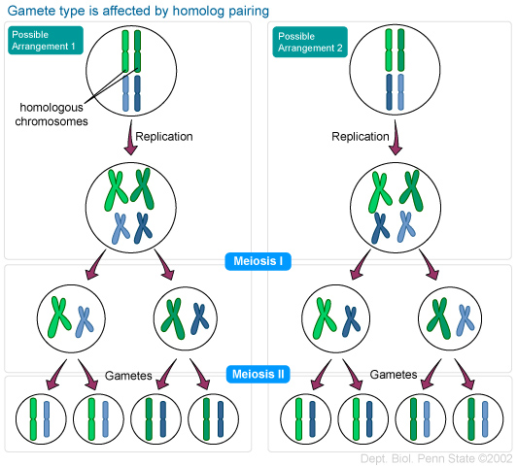
Meiosis 1 and II: Male vs Female

Slide 10
Functions of meiosis
During meiosis, one cell in an organism’s reproductive system divides twice to form four 1n cells.
In males, these gametes become sperm.
In females, only one of these four new cells becomes an egg.
The rest of the cells dissolve back into the organism (or are never produced at all).

Slide 11
Differences of meiosis and mitosis.
Meiosis only occurs in reproductive tissues!
Only cells that are to become gametes go through meiosis. All other cells divide through mitosis.
A cell that divide by meiosis goes through two cell divisions, but the chromosomes are not copied before the second division. In mitosis, the chromosomes are always copied before division.
Daughter cells produced by meiosis, which are haploid (1n), only contain half the genetic material of the parent cell.
Daughter cells produced during mitosis, which are diploid (2n), contain exactly the same genetic material as the parent.

Slide 12
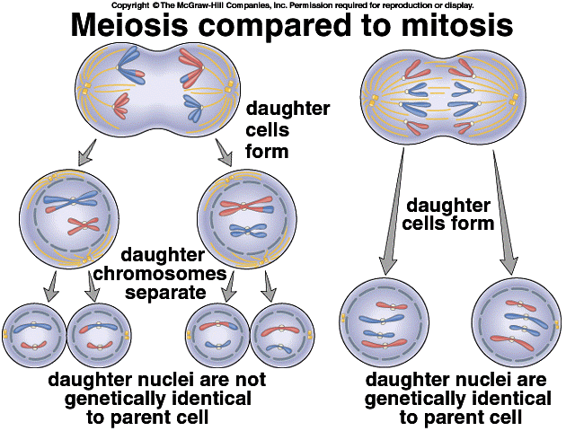
Differences of meiosis and mitosis.

Slide 13
Video Clips…
http://ed.ted.com/lessons/sex-determination-more-complicated-than-you-thought 5:46
http://www.youtube.com/watch?v=toWK0fIyFlY 7:40
http://www.youtube.com/watch?v=qCLmR9-YY7o 11:43
Brainpop- Gender, Twins

