Slide 1
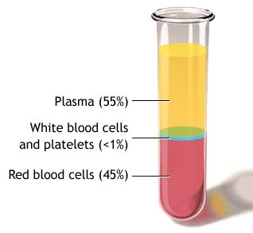
Components of Blood
Your blood has four components:
Plasma
White blood cells (leukocytes)
Red blood cells (erythrocytes)
Platelets (thrombocytes)

Slide 2
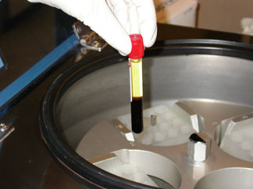
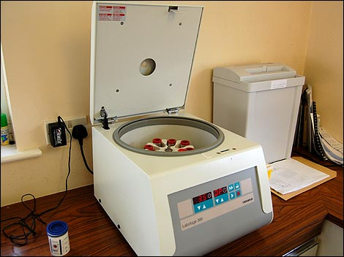

Slide 3
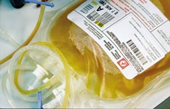
PLASMA
Plasma makes up 55% of your blood.
This fluid contains proteins, glucose, hormones, gases, and other substances dissolved in water.

Slide 4
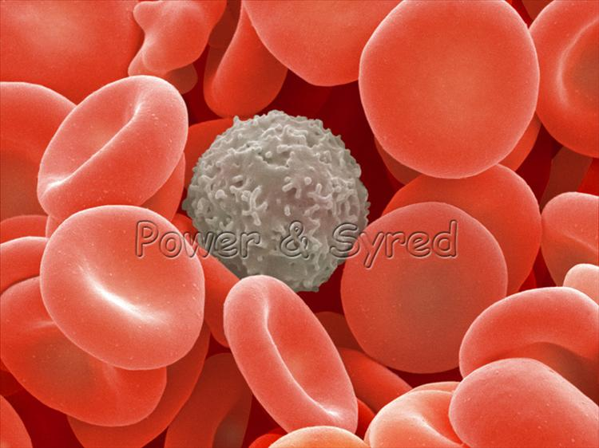
RED BLOOD CELLS AND WHITE BLOOD CELLS
RED BLOOD CELLS
Pick up oxygen and transport it through the body, delivering it to other cells
WHITE BLOOD CELLS
Help your body fight infection by attacking disease-causing organisms

Slide 5
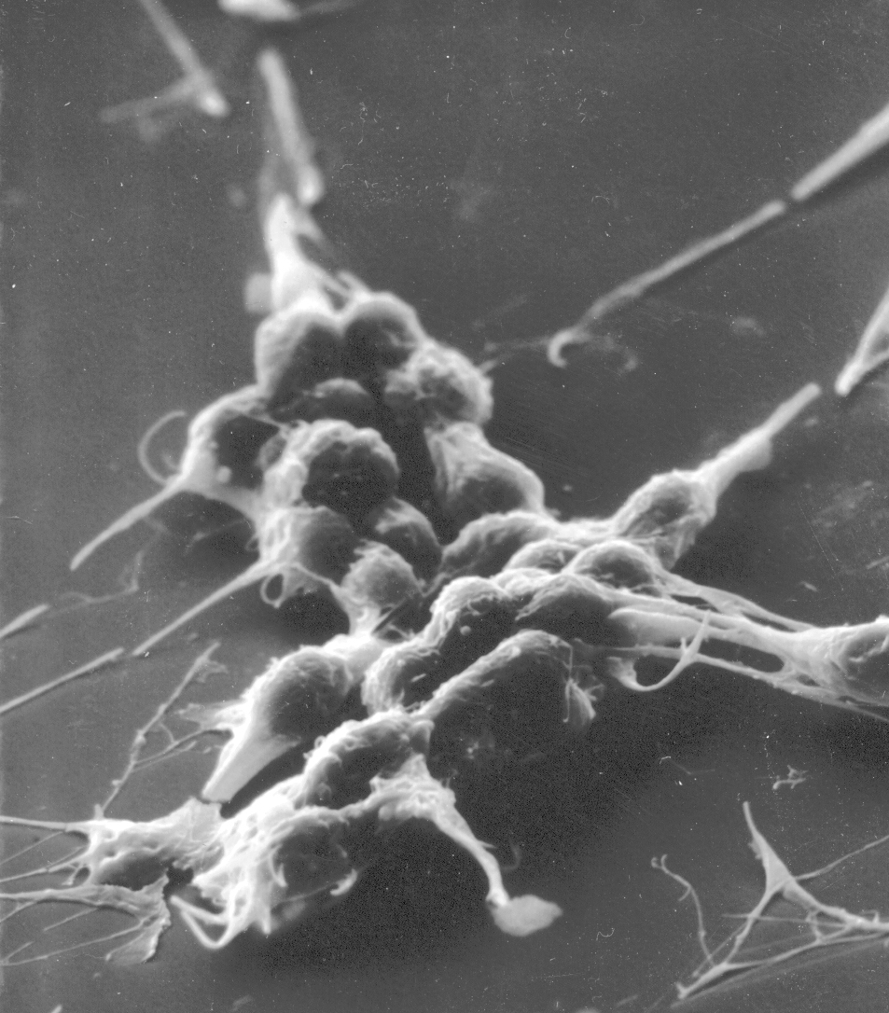
PLATELETS
Platelets are large cell fragments that help form blood clots when a blood vessel is injured.
After an injury occurs, platelets nearby begin to enlarge and become sticky, sticking to the injured area and releasing blood-clotting chemicals.
Blood clotting keeps blood vessels from losing too much blood.

