Slide 1
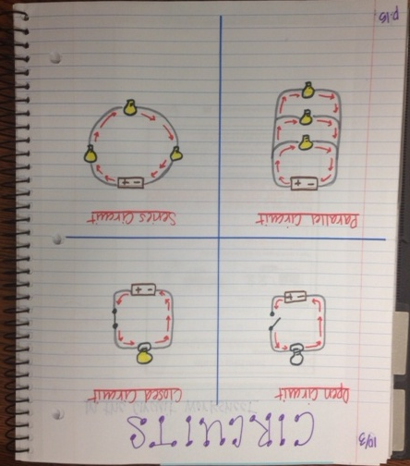
Page 48 should be set up and should look JUST LIKE THIS. USE PENCIL FIRST!! Make sure that you draw your diagrams EXACTLY like they are drawn here. I don’t care what colors you use except for the bulbs. They need to be either yellow or white like they are in my drawings. Make sure your arrows are all facing the right direction.

Slide 2
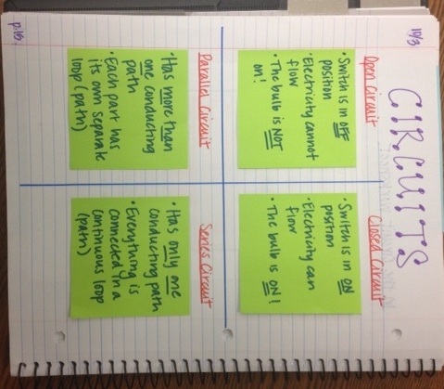
You should use the four squares of paper and make them look JUST LIKE my green ones. Write the exact same text and then tape them in each with one SMALL piece of tape at the top so you can flip the squares up to see the drawings underneath. IF THIS IS NOT NEAT, I WILL MAKE YOU REDO IT!

