Slide 1
Asexual/ Sexual Reproduction
Chapter 3.3

Slide 2
Asexual Reproduction
Involves ONE PARENT!!!
How most unicellular and some multicellular organisms reproduce by cell division.
One organism (parent) produces one or more new organisms (offspring) that are genetically identical to itself AND live independently of it.
This is different than mitosis/cytokinesis because the daughter cells produced from mitosis CANNOT survive on their own.

Slide 3
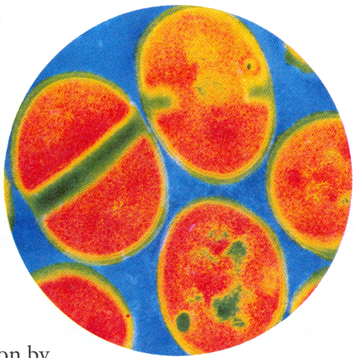
Cell Division in Unicellular Organisms
Cell division and reproduction are the same thing in all single-celled (unicellular) organisms.
Binary fission- form of asexual reproduction in prokaryotes.
Parent organism splits into two, producing two completely independent and genetically identical daughter cells
Example: bacteria
http://www.youtube.com/watch?v=yiA-rHx0xGI

Slide 4
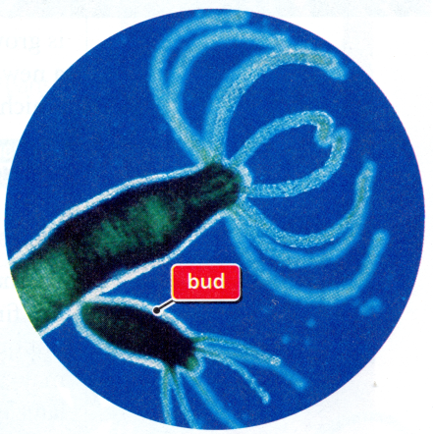
Budding
Both unicellular and multicellular organisms can reproduce by budding.
Budding is when an organism develops tiny buds on its body. Each bud forms from the parent’s cells, so the bud’s genetic material is identical to the parent’s.
Sometimes a new organism may remain attached to the parent until it reaches a certain size.
Example: hydra, yeast, potato’s “eye”
http://www.youtube.com/watch?v=yiA-rHx0xGI

Slide 5
Regeneration
In certain multicellular organisms, specialized cells at the site of a wound or lost limb are able to become different types of tissues.
Regeneration is the process of new tissue growth at these sites.
Example: starfish, plants
http://www.youtube.com/watch?v=d5dOSyaKWTQ

Slide 6
Sexual Reproduction
Sexual reproduction involves two parents.
Reproduction of multicellular organisms often involves sexual reproduction as well as asexual cell division.
Asexual Reproduction | Sexual Reproduction
Cell Division | Cell division and other processes
One parent organism | Two parent organisms
Rapid rate of reproduction | Slower rate of reproduction
Offspring identical to parent | Offspring have genetic information from two parents

