Slide 1
Severe Weather Patterns

Slide 2
Hurricanes Form Over Warm Ocean Water
Near the equator, warm ocean water provides the energy that can turn a low-pressure center into a violent storm.
A tropical storm is a low-pressure system that starts near the equator and has winds that blow at 40 mph.
A hurricane is a tropical low-pressure system with winds blowing at speeds of 74 mph.
Hurricanes are called typhoons or cyclones when they form over the Indian Ocean or Western Pacific Ocean.

Slide 4
Formation of Hurricanes
In the eastern United States, hurricanes most often strike between August and October.
Tropical storms and hurricanes generally move westward with the trade winds.
As soon as a hurricane moves over land or cooler water, it loses its source of energy.

Slide 5
Formation of Hurricanes
At the center of a hurricane is a small area of clear weather 10-30mi in diameter, called the eye.
The storm’s center is calm because air moves downward there.
Just around the eye, the air moves very quickly around and upward, forming a tall ring of cumulonimbus clouds called the eye wall. This ring produces very heavy rains and tremendous winds.

Slide 7
Effects of Hurricanes
These storms can cause damage and dangerous condition. Hurricanes can lift cars, uproot trees, and tear the roofs off buildings.
When a hurricane moves into a coastal area, it often pushes a huge mass of ocean water called a storm surge.
The National Hurricane Center helps people know when to prepare for a hurricane.

Slide 8
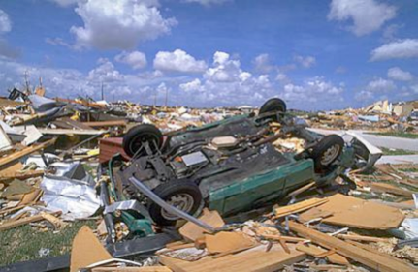
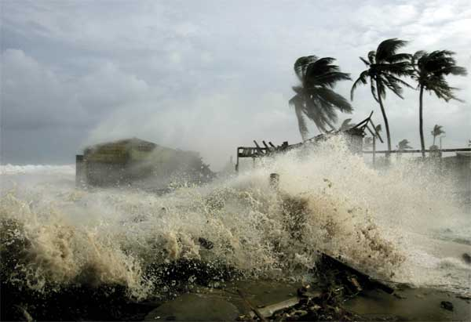
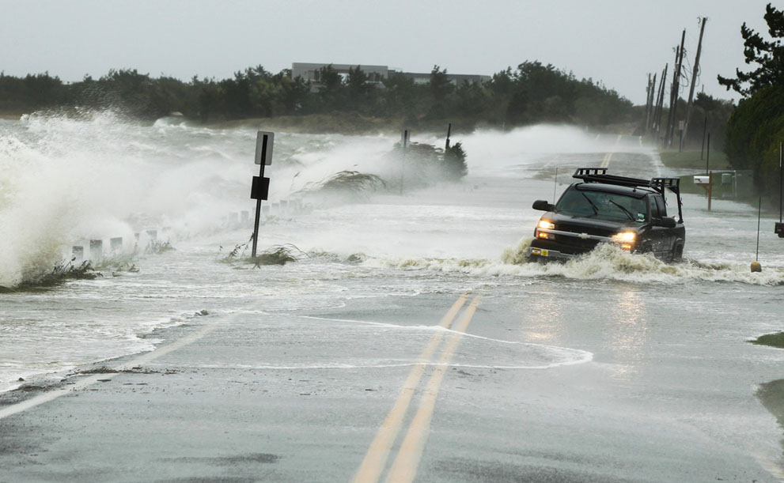
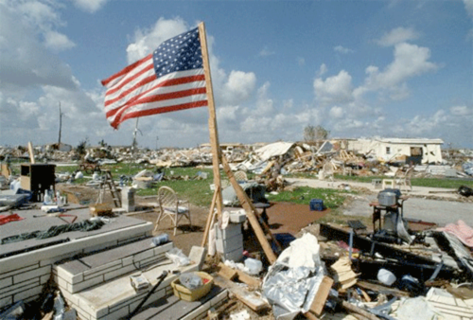

Slide 9
Video clips…
Hurricane Katrina
http://www.youtube.com/watch?v=s76Qn7bpCsQ
http://www.youtube.com/watch?v=QBB_PZy4p84&feature=related
http://www.youtube.com/watch?v=eT5K6FR_eVs&feature=related

Slide 10
Winter Storms Produce Snow and Ice
The National Weather Service alerts people to dangerous weather. A warning means that the dangerous conditions are already present or will affect an area shortly.
Blizzards are blinding snowstorms with winds of at least 35 mph and low temperatures usually below 20.
Some of the heaviest snows fall in the areas of just east and south of the Great Lakes.
Cold air from the Northwest gains moisture and warmth as it passes over the Great Lakes. Over cold land, the air cools again and releases moisture as snow.

Slide 11
Winter Storms Produce Storms and Ice
Some of the heaviest snows fall in the areas of just east and south of the Great Lakes.
Cold air from the Northwest gains moisture and warmth as it passes over the Great Lakes.
Over cold land, the air cools again and releases moisture as snow.

Slide 12
Severe Storms

Slide 13
Thunderstorms Form From Rising Moist Air
Air around lightning is briefly heated to a temperature hotter than the surface of the sun.
This fast heating produces a sharp wave of air that travels away from the lightning.
When the wave reaches you, you hear as a crack of thunder.
A Thunderstorm is a storm with lightning and thunder.

Slide 14
Formation of Thunderstorms
Thunderstorms get their energy from humid air.
Rising humid air forms a cumulus cloud. The water vapor releases energy when it condenses into cloud droplets. This energy increases the air motion.
The cloud continues building up into the tall cumulonimbus cloud of a thunderstorm. Ice particles form in the low temperatures near the top of the cloud. As the ice particles grow large, they begin to fall and pull cold air down with them.
This strong downdraft brings heavy rain or hail. The downdraft can spread out and block more warm air from moving upward into the cloud. The storm slows and ends.
Thunderstorms can form at a cold front or within an air mass.

Slide 15
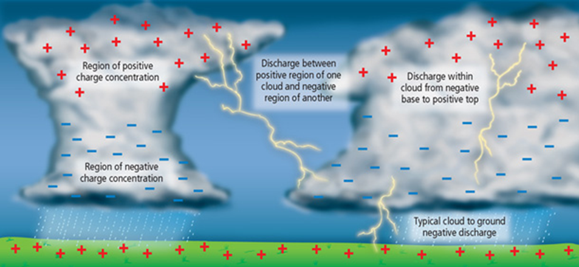
Thunderstorm Formation

Slide 16
Effects of Thunderstorms
Flash Flood can be strong enough to wash away people, cars and even houses.
Winds from a thunderstorm can be very strong. They can blow in bursts that exceed 170 mph.
Hail causes nearly $1 billion in damage to property and crops in the US every year.
Lightening can kill or seriously injure any person it hits.

Slide 17
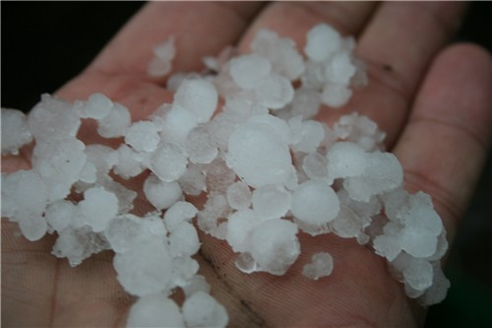
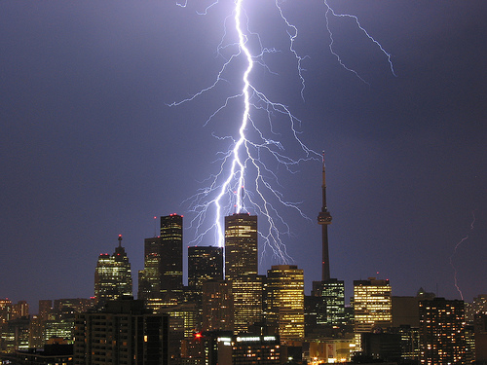
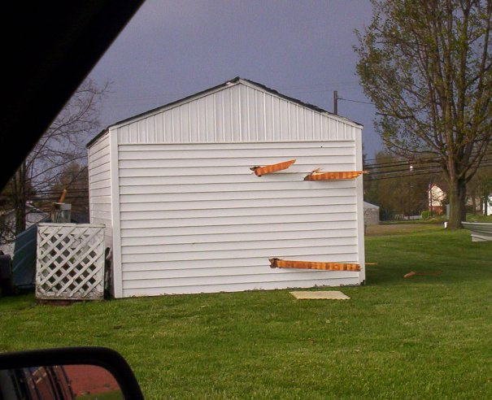
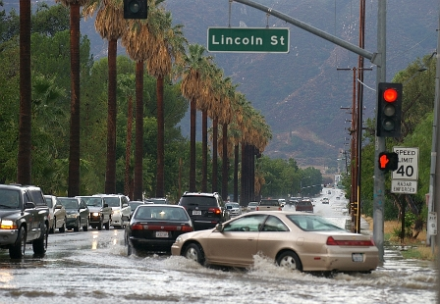

Slide 18
Tornadoes Form in Severe Thunderstorms
A tornado is a violently rotating column of air stretching from a cloud to the ground.
A tornado can become visible when water droplets appear below the cloud in the center of the rotating column.
More tornadoes occur in North America than anywhere else in the world.

Slide 19
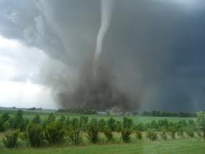
Tornado Formation

Slide 20
Effects of Tornadoes
A typical path of a tornado along the ground may be 300 ft wide and 1 mile long.
About 20 percent of all tornadoes are violent enough to lift or completely demolish sturdy buildings.
A tornado moves along with its thunderstorm. It travels at the same pace and weaves a path that is impossible to predict.
The National Weather Service issues a watch when the weather conditions might produce tornadoes. A warning is issued when a tornado has been detected.

Slide 21
http://www.youtube.com/watch?v=eDK-EJPM_e4&feature=relmfu

Slide 22
Other video clips…
Japan tsunami
http://www.youtube.com/watch?v=iQfdl7y-blE
http://www.youtube.com/watch?v=TRDpTEjumdo
water spout
http://www.youtube.com/watch?v=pr1gGkykgsw

